Slide 2
Objectives Overview
Explain why computer literacy is vital to success in today’s world
Define the term, computer, and describe the relationship between data and information
Describe the five components of a computer
Discuss the advantages and disadvantages that users experience when working with computers
Define the term, network, and identify benefits of sharing resources on a network
Discuss the uses of the Internet and World Wide Web
See Page 3
for Detailed Objectives

Slide 3
Objectives Overview
Distinguish between system software and application software
Differentiate among types, sizes, and functions of computers in each category
Describe the role of each element in an information system
Explain how home users, small office/home office users, mobile users, power users, and enterprise users each interact with computers
Discuss how society uses computers in education, finance, government, health care, science, publishing, travel, and manufacturing
See Page 3
for Detailed Objectives

Slide 4
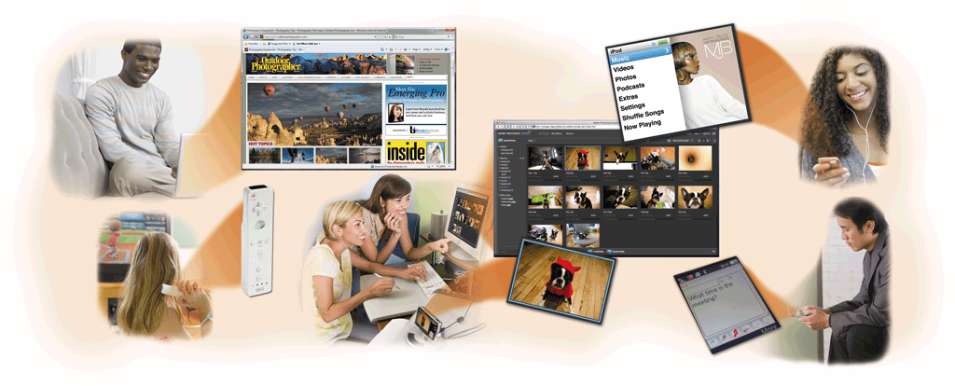
A World of Computers
Computers are everywhere
Pages 4 - 5
Figure 1-1

Slide 5
What Is a Computer?
A computer is an electronic device, operating under the control of instructions stored in its own memory
Collects data (input)
Processing
Produces information (output)
Information Processing Cycle
Page 6

Slide 6
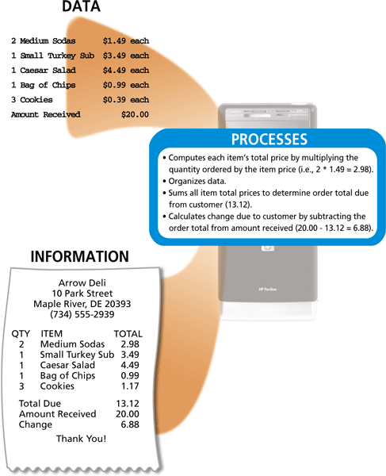
What Is a Computer?
Page 6
Figure 1-2

Slide 7
The Components of a Computer
A computer contains many electric, electronic, and mechanical components known as hardware
Input Device
Output Device
System Unit
Storage Device
Communications Device
Allows you to enter data and instructions into a computer
Hardware component that conveys information to one or more people
Case that contains the electronic components of the computer that are used to process data
Holds data, instructions, and information for future use
Enables a computer to send and receive data, instructions, and information to and from one or more computers or mobile devices
Pages 6 - 8

Slide 8
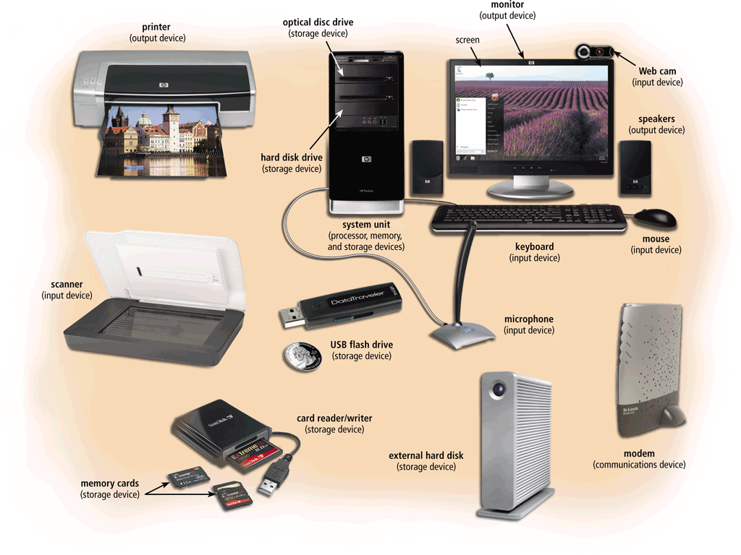
The Components of a Computer
Page 7
Figure 1-3

Slide 9
Advantages and Disadvantages of Using Computers
Advantages of Using Computers
Disadvantages of Using Computers
Speed
Reliability
Consistency
Storage
Communications
Health Risks
Violation of Privacy
Public Safety
Impact on Labor Force
Impact on Environment
Pages 9 - 10

Slide 10
Advantages and Disadvantages of Using Computers
Green computing involves reducing the electricity consumed and environmental waste generated when using a computer
Strategies include:
Recycling
Regulating manufacturing processes
Extending the life of computers
Immediately donating or properly disposing of replaced computers
Click to view Web Link, click Chapter 1, Click Web Link from left navigation,
then click Green Computing below Chapter 1
Page 10

Slide 11
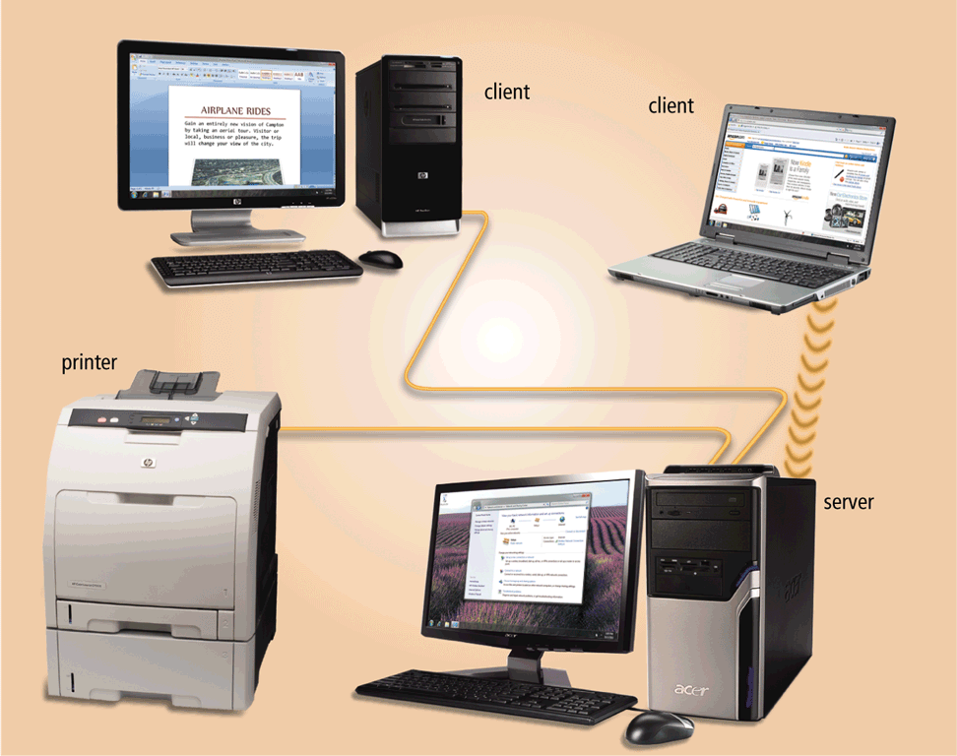
Networks and the Internet
A network is a collection of computers and devices connected together, often wirelessly, via communications devices and transmission media
Pages 10 - 11
Figure 1-6

Slide 12
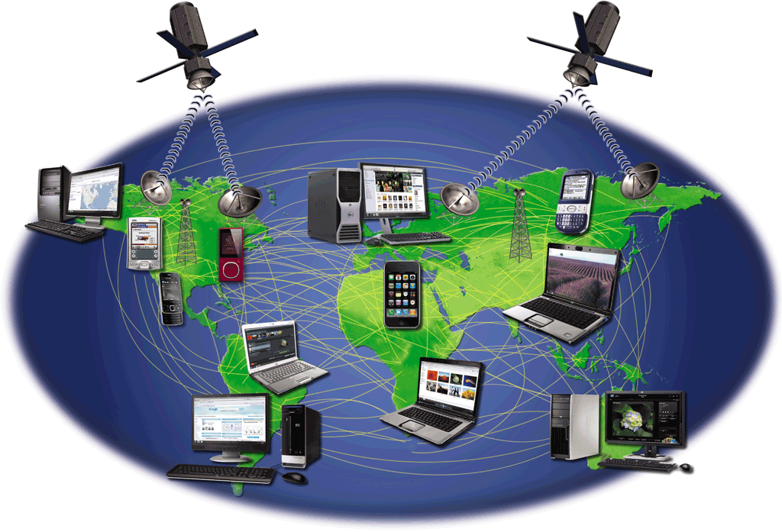
Networks and the Internet
The Internet is a worldwide collection of networks that connects millions of businesses, government agencies, educational institutions, and individuals
Click to view Web Link, click Chapter 1, Click Web Link from left navigation,
then click The Internet below Chapter 1
Page 11
Figure 1-7

Slide 13
Networks and the Internet
People use the Internet for a variety of reasons:
Communicate
Research and Access Information
Shop
Bank and Invest
Online Trading
Entertainment
Download Videos
Share Information
Web Application
Pages 12 - 13
Figure 1-8

Slide 14
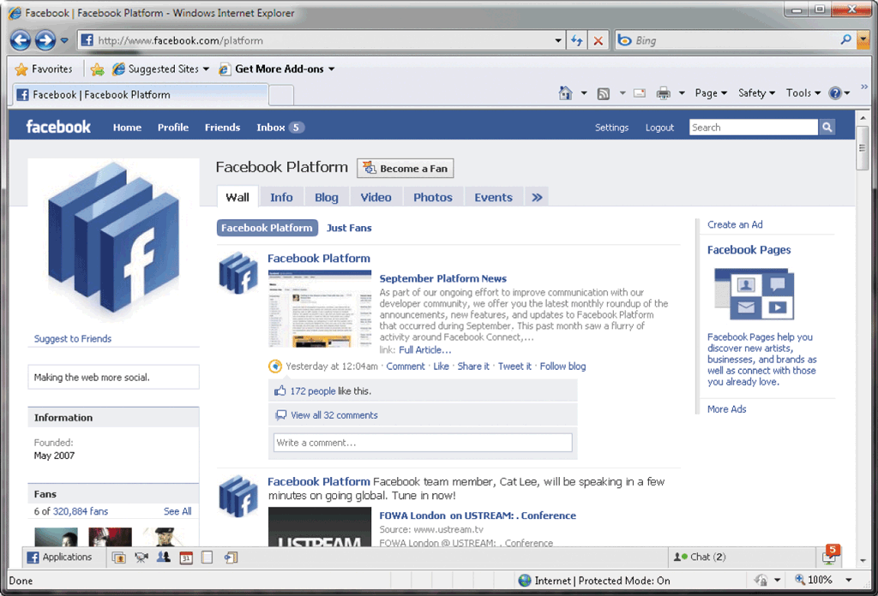
Networks and the Internet
A social networking Web site encourages members to share their interests, ideas, stories, photos, music, and videos with other registered users
Click to view Web Link, click Chapter 1, Click Web Link from left navigation,
then click Facebook below Chapter 1
Page 14
Figure 1-9

Slide 15
Computer Software
Software, also called a program, tells the computer what tasks to perform and how to perform them
System Software
Operating system
Utility program
Application Software
Click to view Web Link, click Chapter 1, Click Web Link from left navigation,
then click Windows below Chapter 1
Pages 15 - 16
Figures 1-10 - 1-11

Slide 16
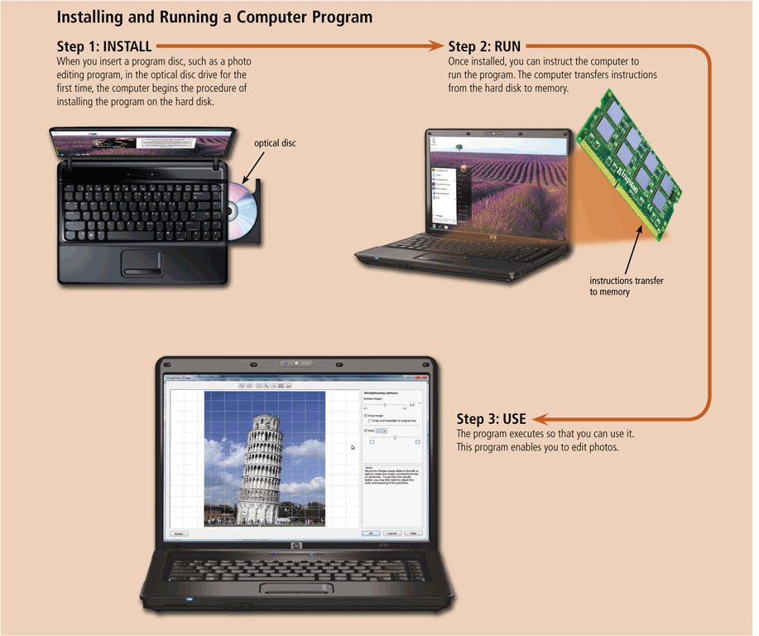
Computer Software
Installing is the process of setting up software to work with the computer, printer, and other hardware
Pages 16 - 17
Figure 1-12

Slide 17
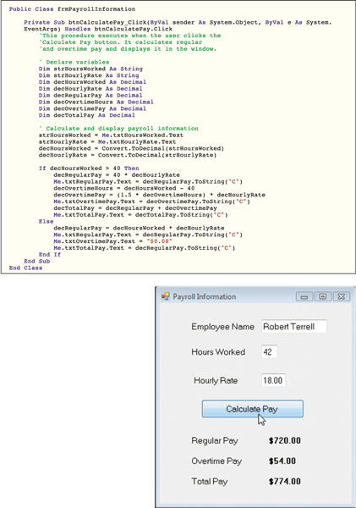
Computer Software
A programmer develops software or writes the instructions that direct the computer to process data into information
Page 18
Figure 1-13

Slide 18
Categories of Computers
Personal computers
Mobile computers and mobile devices
Game consoles
Servers
Mainframes
Supercomputers
Embedded computers
Page 19

Slide 19
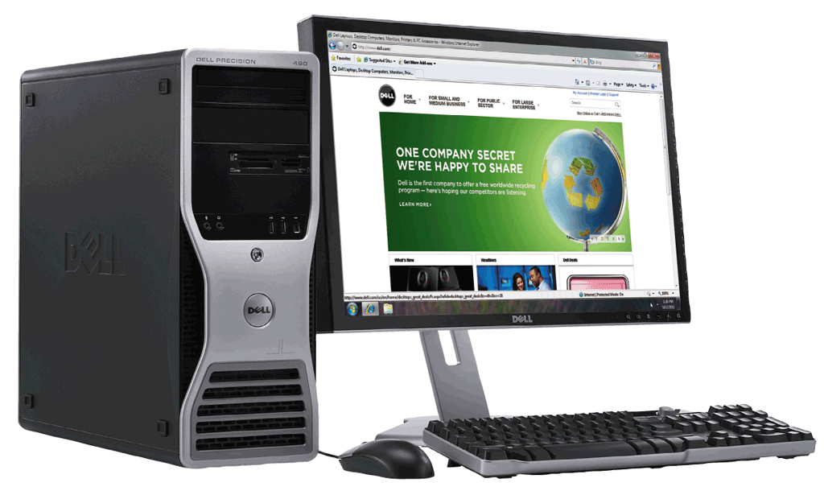
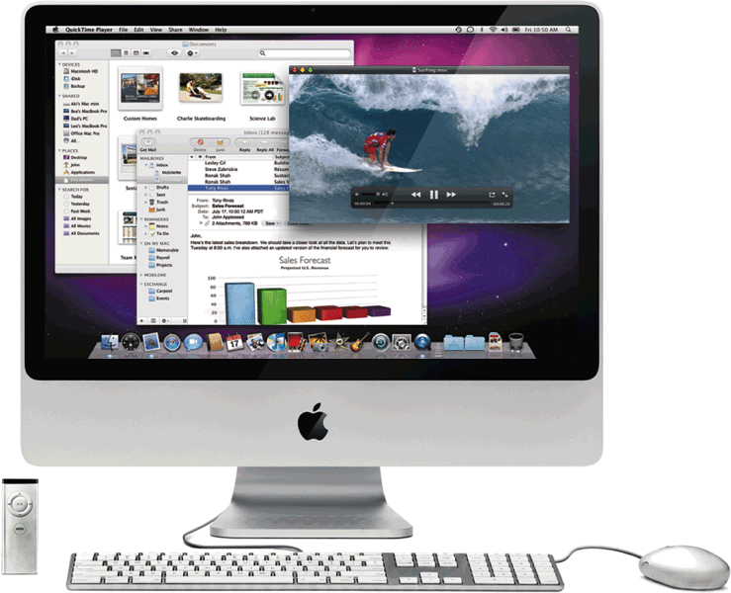
Personal Computers
A personal computer can perform all of its input, processing, output, and storage activities by itself
Two popular architectures are the PC and the Apple
Desktop computer
Page 19
Figures 1-15 - 1-16

Slide 20
Mobile Computers and Mobile Devices
Mobile Computer
Personal computer you can carry from place to place
Mobile Device
Computing device small enough to hold in your hand
Examples include smart phones, PDAs, handheld computers, portable media players, and digital cameras
Examples include notebook computers, laptop computers, netbooks, ultra-thins, and Tablet PCs
Pages 20 - 23

Slide 21
Mobile Computers and Mobile Devices
Notebook computer
Tablet PC
Smart phone
PDA
Click to view Web Link, click Chapter 1, Click Web Link from left navigation,
then click Camera Phone below Chapter 1
Pages 20 - 22
Figures 1-17 – 1-20

Slide 22
Mobile Computers and Mobile Devices
Handheld computer
Portable media player
Digital camera
Click to view Web Link, click Chapter 1, Click Web Link from left navigation,
then click Digital Cameras below Chapter 1
Pages 22 - 23
Figures 1-21 – 1-23

Slide 23
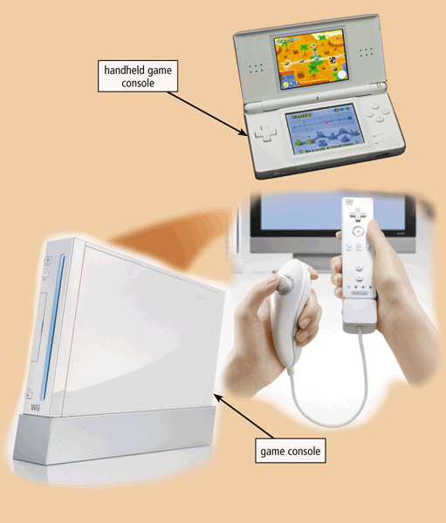
Game Consoles
A game console is a mobile computing device designed for single-player or multiplayer video games
Page 24
Figure 1-24

Slide 24
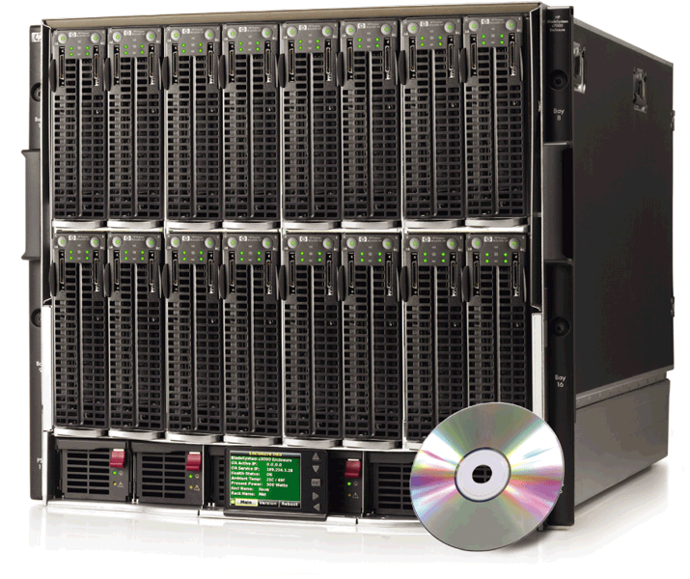
Servers
A server controls access to the hardware, software, and other resources on a network
Provides a centralized storage area for programs, data, and information
Page 25
Figure 1-25

Slide 25
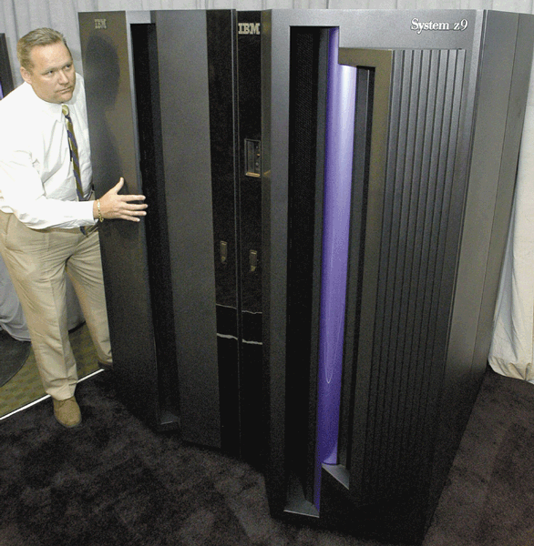
Mainframes
A mainframe is a large, expensive, powerful computer that can handle hundreds or thousands of connected users simultaneously
Page 25
Figure 1-26

Slide 26
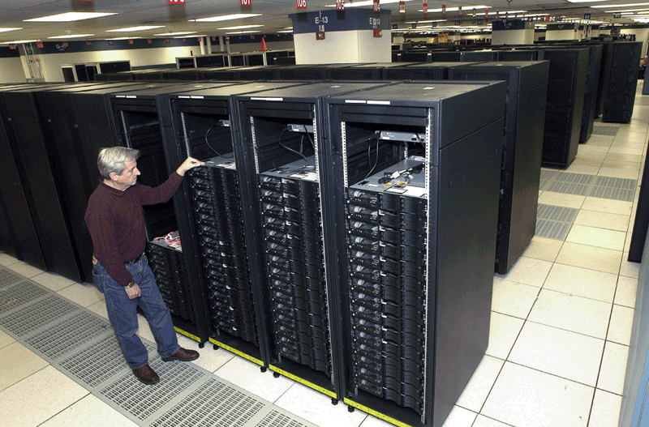
Supercomputers
A supercomputer is the fastest, most powerful computer
Fastest supercomputers are capable of processing more than one quadrillion instructions in a single second
Page 25
Figure 1-27

Slide 27
Embedded Computers
An embedded computer is a special-purpose computer that functions as a component in a larger product
Consumer Electronics
Home Automation Devices
Automobiles
Process Controllers and Robotics
Computer Devices and Office Machines
Mobile and digital telephones
Digital televisions
Cameras
Video recorders
DVD players and recorders
Answering machines
Thermostats
Sprinkling systems
Security monitoring systems
Appliances
Lights
Antilock brakes
Engine control modules
Airbag controller
Cruise control
Remote monitoring systems
Power monitors
Machine controllers
Medical devices
Keyboards
Printers
Faxes
Copiers
Page 26

Slide 28
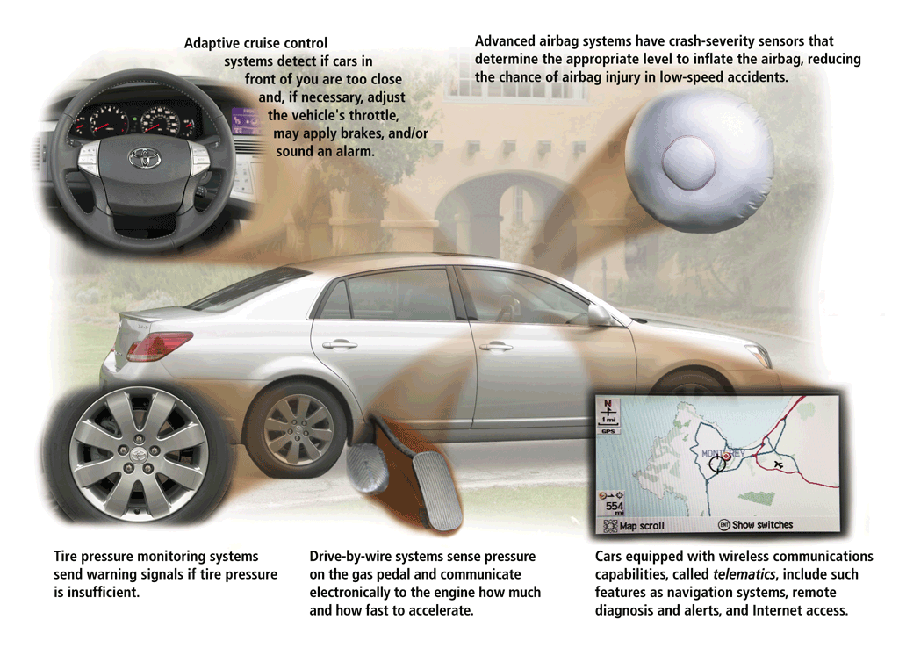
Embedded Computers
Page 26
Figure 1-28

Slide 29
Elements of an Information System
Hardware
Software
Data
People
Procedures
Click to view Web Link, click Chapter 1, Click Web Link from left navigation,
then click Women in Technology below Chapter 1
Page 27

Slide 30
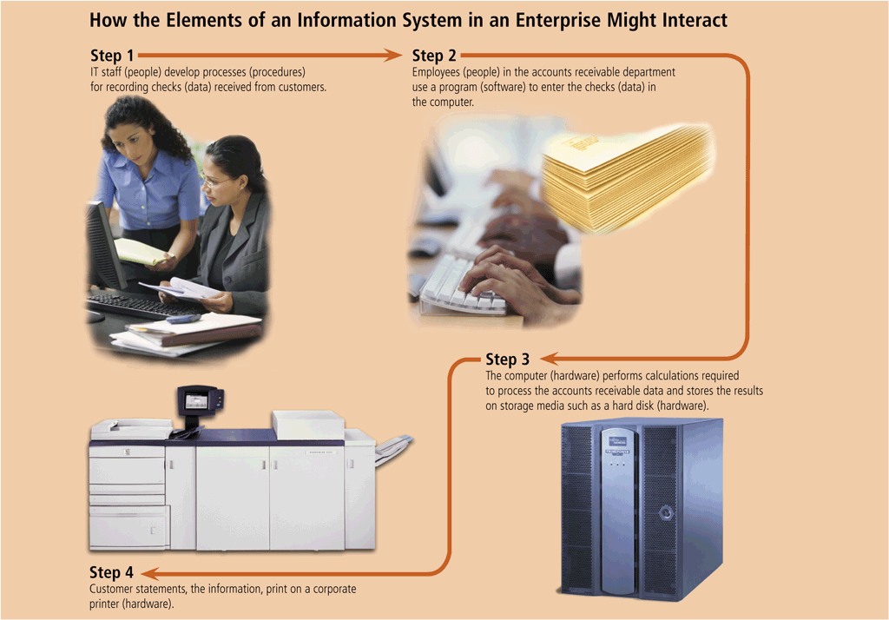
Elements of an Information System
Page 27
Figure 1-29

Slide 31
Examples of Computer Usage
Home User
Small Office/Home Office User
Mobile User
Personal financial management
Web access
Communications
Entertainment
Look up information
Send and receive e-mail messages
Make telephone calls
Connect to other computers on a network or the Internet
Transfer information
Play video games
Listen to music
Watch movies
Click to view Web Link, click Chapter 1, Click Web Link from left navigation,
then click Minorities in Technology below Chapter 1
Pages 28 – 31
Figures 1-30 – 1-32

Slide 32
Examples of Computer Usage
Power User
Enterprise User
Work with multimedia
Use industry-specific software
Communicate among employees
Process high volumes of transactions
Blog
Click to view Web Link, click Chapter 1, Click Web Link from left navigation,
then click Enterprise Computing below Chapter 1
Pages 31 – 32
Figures 1-33 – 1-34

Slide 33
Computer Applications in Society
Education
Finance
Government
Health Care
Pages 34 - 36
Figures 1-36 – 1-39

Slide 34
Computer Applications in Society
Science
Publishing
Travel
Manufacturing
Click to view Web Link, click Chapter 1, Click Web Link from left navigation,
then click OnStar below Chapter 1
Pages 36 - 38
Figures 1-40 – 1-43

Slide 35
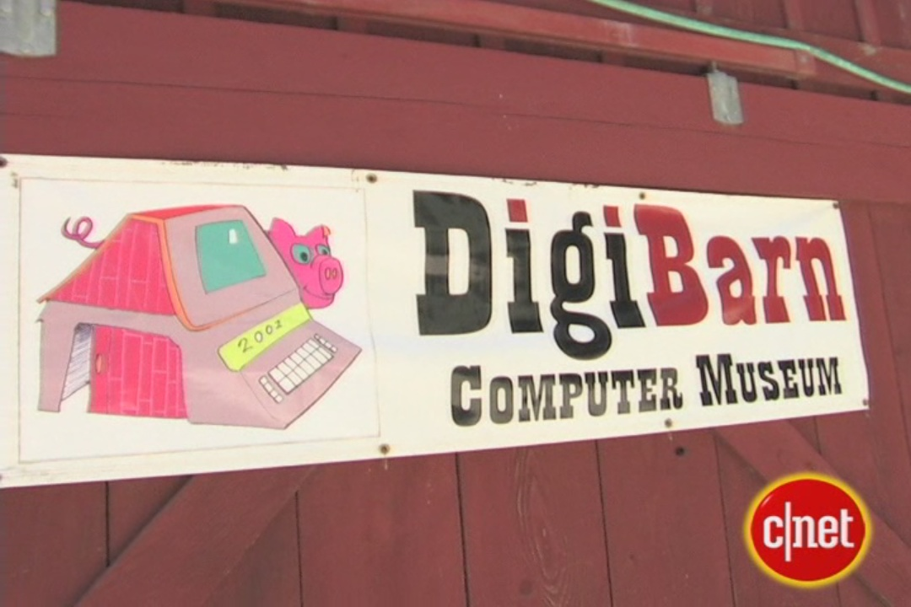
Video: Computer History in a Barn
CLICK TO START

Slide 36
Summary
Basic computer concepts
Components of a computer
Networks, the Internet, and computer software
Many different categories of computers, computer users, and computer applications in society
Page 39

Slide 37
Chapter 1 Complete

